Slide 1














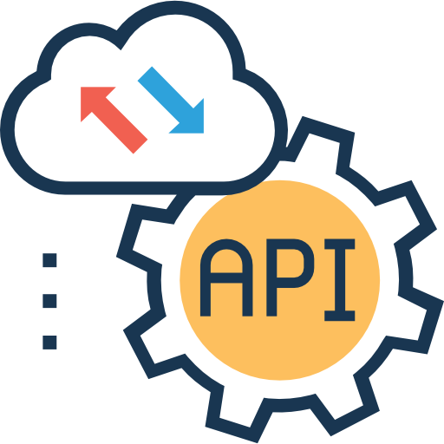












Remediation
Webhooks
& Tickets
Identity Security Fabric
IGA Pipeline: Secure by default
Leverages the same Access Policies
Secrets
Vault
SaaS Service Accounts
Okta Workflows
Privileged Access Management
Resource
Access
Tight
Integration
+
Leverage
the same Integrations
Identity
Security
Posture Management
Compliance Violations
MFA Bypass
Partial Offboarding…
Tight
Integration
Import
Sources
User Matching
User Linking
Secure Identity Integrations
Remediations
Secure Identity Integrations
Workflows
Universal
Directory
Govern Anomalies
User Access Context
+
+
+
+
+
Onboarding
Offboarding
Data Transformation
Entitlement
Policies
User Onboarded
Applications Provisioned
OR Updated
OR Offboarded
Identity Governance
Access Reviews
Flexible
Multi Step Review
Flexible
Data Processing
SoD
Any Source
of Truth
700+ Provisioning Integrations
SaaS and On-Prem
+
+
Access
Request
Flexible
Multi Step Approval
Integrations and Workflows
Security Evaluations
Approval Workflow Callouts
Time Bound Requests
Fulfillment
Secure Identity Integrations
Unified Security Outcomes
Tightly Integrated with
Okta Dashboard
Chat Systems
ITSMs

Slide 2





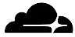


























Identity Security Fabric
Access Pipeline: Secure by default
Breached
Password Detection
Custom
Security Remediations
Identity
Verification
Continuous Access Evaluation (CAEP)
+
Recovery
Begin
Recovery
Present
Recovery Factors
Update Credentials/
Authenticator
Resume Login
Universal Logout
Identity
Threat Protection
Entity
Risk Policy
+
Extended Device
SSO
Post Auth Inline Checks
OS + App Access
MFA
Edge Security
ThreatInsights
Device
Access
Application
Sign On Policy
+
+
+
Need Access
Global
Sign On
Policy
Verify Identity
Present Login Options
FastPass
Unmanaged Checks
Network Checks
Risk
Evaluation
Enrich User
Grant Access
Device
Posture
Checks
Device
Assurance
Policies
Token
Inline
Hooks
Integrations and Workflows
Security Evaluations
Unified Security Outcomes

